Slide 1


Delta learning rule for multi-perceptron layer
=============================================================================
WWW.THEMLLABS.COM || contact@themllabs.com || Phone : 91-7338339898, 91-6362546088

Slide 2
Agenda
Delta Learning Rule for Multilayer Perceptron
Generalized Delta Learning Rule
=============================================================================
WWW.THEMLLABS.COM || contact@themllabs.com || Phone : 91-7338339898, 91-6362546088

Slide 3
Delta Learning Rule for Feedforward Multilayer Perceptron
The training algorithm is called error back propagation training algorithm
If a submitted pattern provides an output far from desired value, the weights and thresholds are adjusted s.t. the current mean square classification error is reduced.
The training is continued/repeated for all patterns until the training set provide an acceptable overall error.
The weight adjustment propagate backward from output layer through hidden layer toward input layer.
=============================================================================
WWW.THEMLLABS.COM || contact@themllabs.com || Phone : 91-7338339898, 91-6362546088

Slide 4
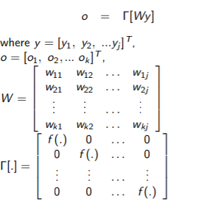
Input: yj , j = 1, 2, ..., J, Output:
ok , k = 1, ..., R and weights between output of the jth neuron and input of the kth neuron: wkj
=============================================================================
WWW.THEMLLABS.COM || contact@themllabs.com || Phone : 91-7338339898, 91-6362546088

Slide 5
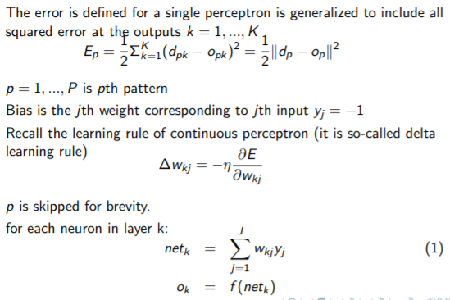
Desired output vector d = [d1, d2, ..., dk ] T
The activation vector is netk = Wy
=============================================================================
WWW.THEMLLABS.COM || contact@themllabs.com || Phone : 91-7338339898, 91-6362546088

Slide 6
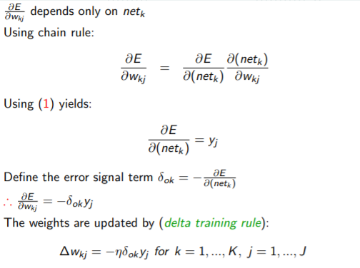
=============================================================================
WWW.THEMLLABS.COM || contact@themllabs.com || Phone : 91-7338339898, 91-6362546088

Slide 7
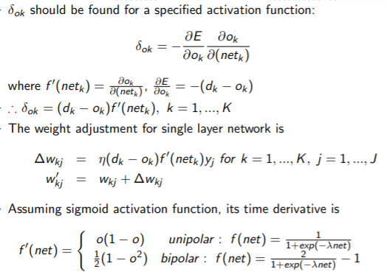
=============================================================================
WWW.THEMLLABS.COM || contact@themllabs.com || Phone : 91-7338339898, 91-6362546088

Slide 8
Generalized Delta Learning Rule
Delta learning rule is a supervised rule which adjusts the weights based on error between neuron output and desired output
In multiple layer networks, the desired output of internal layer is not available.
Delta learning rule cannot be applied directly
Assuming input as a layer with identity activation function, the network shown in fig is a three layer network (some times it is called a two layer network)
Since output of jth layer is not accessible it is called hidden layer
=============================================================================
WWW.THEMLLABS.COM || contact@themllabs.com || Phone : 91-7338339898, 91-6362546088

Slide 9
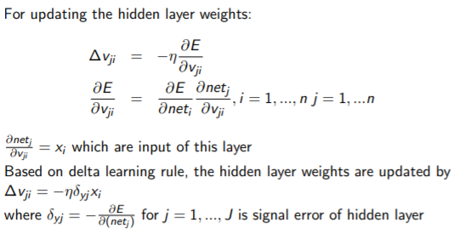
The weights of output layer w can be updated based in delta rule, since desired output is available for them
=============================================================================
WWW.THEMLLABS.COM || contact@themllabs.com || Phone : 91-7338339898, 91-6362546088

Slide 10
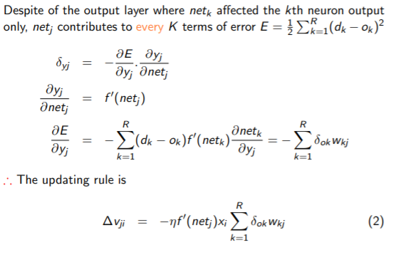
=============================================================================
WWW.THEMLLABS.COM || contact@themllabs.com || Phone : 91-7338339898, 91-6362546088

Slide 11
So the generalized delta rule is:
∆v = −ηδx (3)
where η is learning const., δ is layer error, and x is layer input.
The weights of jth layer is proportional to the weighted sum of all δ of next layer.
Delta training rule of output layer and generalized delta learning rule for hidden layer have fairly uniform formula.
=============================================================================
WWW.THEMLLABS.COM || contact@themllabs.com || Phone : 91-7338339898, 91-6362546088

Slide 12
But I δo = (dk − ok )ok (1 − ok ) contains scalar entries, contains error between desired and actual output times derivative of activation function
δy = wj δo f 0 y contains the weighted sum of contributing error signal δo produced by the following layer
The generalized learning rule propagates the error back by one layer.
=============================================================================
WWW.THEMLLABS.COM || contact@themllabs.com || Phone : 91-7338339898, 91-6362546088

